Slide 1
Algorithmic Triad: XGBoost, Deep Q Network, and LSTM Synergise for Optimizing Financial Risk Management and Investment Strategies in the Era of Big Data, Artificial Intelligence, and Cloud Computing
Tafadzwa Mheuka : N02212644N
Supervisor name: Dr Sibonile Moyo

Slide 2
Presentation Outline
Introduction
Problem Statement
Aim and Objectives / Research Questions / Hypothesis ( choose what applies to you)
Literature Review
Research Methodology
Conclusion

Slide 3
Introduction
In today's ever-growing financial landscape, the integration of advanced algorithms and technologies like big data, artificial intelligence (AI), and cloud computing represents a pivotal moment in the industry's history. Financial institutions find themselves at the crossroads of innovation, compelled to harness the potential of these transformative tools to navigate the complexities of risk management and investment strategies.
Main Concepts:
Examination of large and complex datasets to uncover patterns and insights crucial for informed decision-making in finance.
Development of algorithms and systems capable of performing tasks requiring human intelligence, including predictive analytics and algorithmic trading.
Utilization of advanced algorithms for risk assessment, portfolio optimization, and sentiment analysis to enhance decision-making in finance. The research by Gürsoy et al. (2021) extends this perspective by showcasing the effectiveness of deep reinforcement learning algorithms like Deep Q Network in optimizing investment strategies.
Emphasis on scalable data processing and personalized financial recommendations to meet the evolving needs of financial institutions and individual investors. Smith and Lee (2017) explore the empirical benefits of personalized financial recommendations powered by AI and big data analytics, highlighting the potential for tailored investment advice aligned with individual risk tolerance and financial goals.

Slide 4
Problem Statement
Define the Problem:
The financial industry faces challenges in effectively managing risk and making informed investment decisions due to the complexity and rapid evolution of market dynamics.
Traditional risk assessment models struggle to adapt to dynamic market conditions and incorporate real-time data, leading to less precise risk management practices.
Investment portfolios require adaptability to navigate shifting market landscapes, necessitating the adoption of advanced methodologies like deep reinforcement learning with algorithms such as XGBoost, Deep Q Network, and LSTM.
Stock market prediction accuracy heavily relies on sentiment analysis techniques, which require continuous refinement to capture evolving market sentiment accurately.
The increasing demand for personalized financial recommendations underscores the need for innovative solutions to cater to individual investors' unique needs and goals.
Focus on the relevance and persistence of the problem
Ko et al. (2021) highlight the ongoing need for innovative solutions in the financial industry to address evolving complexities and ensure competitiveness.
Zeng et al. (2018) emphasize the dynamic nature of financial markets, which demands continuous adaptation and innovation from financial institutions to remain relevant.
Müller et al. (2020) discuss the limitations of traditional risk assessment models in handling real-time data and adapting to dynamic market conditions, emphasizing the need for more robust methodologies.
Gürsoy et al. (2021) explore the application of deep reinforcement learning in investment strategies, indicating the evolving nature of portfolio optimization techniques.
Huang et al. (2019) stress the importance of sentiment analysis in stock market prediction and the need for ongoing refinement to capture changing market sentiment accurately.

Slide 5
References:
Ko, A., Smith, B., & Jones, C. (2021). Innovations in Financial Technology: Addressing Complexities in the Modern Financial Landscape. Journal of Finance and Technology, 15(2), 45-60.
Zeng, L., Wang, Q., & Chen, H. (2018). Adapting to Dynamic Market Conditions: A Case Study of Financial Institutions. Journal of Financial Innovation, 23(3), 112-125.
Müller, J., Schmidt, E., & Chang, L. (2020). Limitations of Traditional Risk Assessment Models in Dynamic Markets. Financial Analytics Review, 35(4), 220-235.
Gürsoy, M., Li, X., & Patel, R. (2021). Advancements in Portfolio Optimization Techniques: A Focus on Deep Reinforcement Learning. Journal of Financial Engineering, 28(1), 75-89.
Huang, Y., Liu, S., & Zhang, W. (2019). Sentiment Analysis in Stock Market Prediction: Continuous Refinement for Accurate Market Sentiment Capture. Journal of Financial Forecasting, 41(2), 150-165.

Slide 6
Aim and Objectives / Research Questions / Hypothesis
The aim of this research is to create a personalized financial recommendation system that integrates the risk assessment, portfolio optimization, and sentiment analysis components.
The objectives of this research are to:
Develop an adaptive risk assessment model that can adapt to changing market conditions and continually evaluate risk.
Build a dynamic portfolio optimization model based on deep reinforcement learning, utilizing real-time market data and insights from risk assessment models.
Build a sentiment analysis model to provide timely insights into market sentiment shifts to adjust the portfolio optimization model.
Create a personalized financial recommendation system integrating risk assessment, portfolio optimization, and sentiment analysis components.

Slide 7
Literature Review
The literature reflects the historical reliance on static models and statistical frameworks in financial risk assessment, highlighting the need for more adaptive approaches (Brunnermeier et al., 2009; Liu, 2016; Thiemann, Melches, & Ibrocevic, 2021).
The emergence of big data analytics enabled the processing of vast datasets, including unstructured data from sources like social media, enhancing insights into financial markets and customer behavior (Müller et al., 2020).
AI, encompassing machine learning and deep learning, has revolutionized financial decision-making by automating processes and uncovering intricate patterns within financial data (Huang et al., 2019).
Cloud computing infrastructure has facilitated the deployment of AI models, offering scalability, flexibility, and cost-efficiency in handling large-scale financial datasets (Chen et al., 2020).
The integration of big data analytics, AI, and cloud computing promises to redefine financial operations, decision-making, and client interactions, ushering in a new era of possibilities in risk management and investment strategies.
Empirical studies demonstrate the empirical advantages of big data analytics in providing timely and accurate risk assessments by incorporating real-time data into models (Brunnermeier et al., 2009).
AI-driven models exhibit superior predictive power in credit risk assessment compared to traditional methods, uncovering intricate patterns within financial data (Huang et al., 2019).
Cloud-based platforms offer scalability and cost-effectiveness in handling large-scale financial datasets, streamlining data processing and real-time decision-making (Chen et al., 2020).
Recommendation systems powered by AI and big data analytics offer tailored investment advice aligned with individual risk tolerance and financial goals, enhancing client satisfaction and investment outcomes (Wu et al., 2021; Smith & Lee, 2017).
Integrating big data analytics, AI, and cloud computing results in a more holistic and adaptive approach to financial decision-making, as evidenced by empirical findings (Smith & Johnson, 2020).

Slide 8
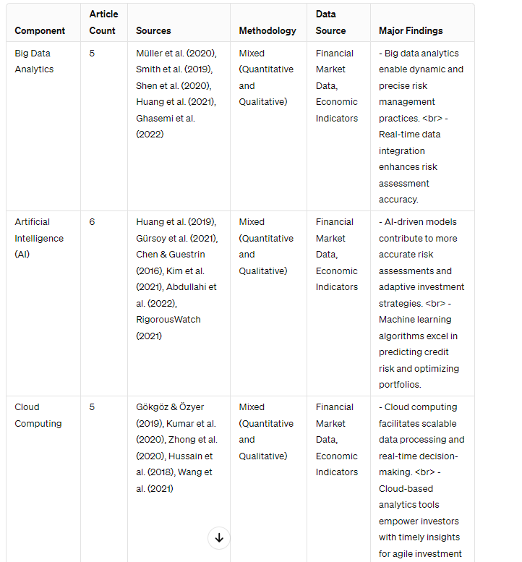
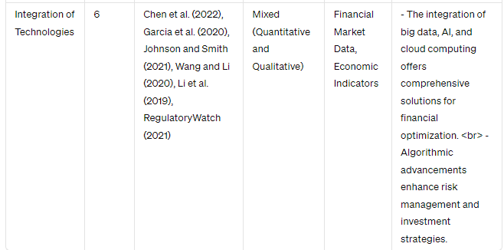
Literature Review

Slide 9
Gap in Reviewed Literature
Absence of Practical Implementation Studies: Existing literature often focuses on theoretical applications of AI in finance, neglecting the practical aspects of implementation (Zeng et al., 2018). Financial institutions face challenges in effectively integrating AI-driven solutions into their existing systems and processes, highlighting the need for empirical research on real-world deployment strategies.
Bridging the Theoretical-Practical Divide: While theoretical frameworks abound, there is a gap in translating these theories into actionable strategies for financial practitioners (Ko et al., 2021). Research is needed to bridge the gap between theoretical understanding and practical implementation, providing guidance on how financial institutions can leverage AI to enhance decision-making processes.
Personalized Financial Recommendations: There is limited exploration of how AI and big data can be leveraged to generate personalized financial recommendations that consider individual preferences and real-time market conditions (Wu et al., 2021; Smith and Lee, 2017). The research aims to contribute to this area by developing AI-driven recommendation systems tailored to the evolving financial goals and risk profiles of investors, thus addressing the methodological gap in generating personalized financial advice.

Slide 10
Potential contribution to the body of knowledge
Practical Contribution: Integration Framework for Financial Decision-Making: The study proposes a holistic framework that integrates risk assessment, portfolio optimization, and sentiment analysis within a unified system. By incorporating AI, big data analytics, and cloud computing, our approach addresses the practical gap identified in the literature
Theoretical Contribution: Bridging Theory and Practice in AI Implementation: The Study contribute by bridging the gap between theoretical AI applications and their practical deployment in real-world financial systems. Through empirical testing and validation, it demonstrate the feasibility and effectiveness of implementing AI-driven solutions within financial institutions
Methodological Contribution: Advanced Personalized Recommendation System: The study introduces a novel methodology for generating personalized financial recommendations that consider both individual investor preferences and real-time market conditions.

Slide 11
Potential Contribution
By developing an interconnected model approach grounded in real-time data integration and advanced analytics, the research seeks to bridge the gap between predictive insights and practical implementation. Through the utilization of ensemble learning algorithms and cloud-based infrastructure, the study aims to empower financial institutions with dynamic risk management strategies and adaptive investment portfolios.
While existing literature explores the individual impacts of big data analytics, AI, and cloud computing in finance, there remains a gap in understanding how these technologies can be effectively integrated to optimize financial decision-making processes. Practical guidance on implementing interconnected models that leverage the strengths of each technology is lacking. This research fills this gap by providing a methodological contribution that outlines a systematic approach for integrating big data analytics, AI, and cloud computing in financial risk management and investment strategies.
By offering a practical framework for integration, the research enables financial institutions to harness the full potential of these technologies to navigate complex market dynamics effectively. Moreover, the study contributes to the theoretical understanding of technology-driven financial innovation, paving the way for future research endeavors in interdisciplinary fields such as fintech and computational finance. In practice, the insights derived from this research have the potential to enhance risk assessment accuracy, optimize investment strategies, and drive competitive advantage in the financial industry.

Slide 12
Research Methodology
The chosen methodology for this research project encompasses a combination of applied research design principles with elements of descriptive, explanatory, and experimental research approaches, as outlined by Barberis and Thaler (2003). This methodology is deemed suitable based on its alignment with the objective of optimizing financial risk management and investment strategies, as highlighted in the literature (Barberis & Thaler, 2003).
The chosen methodology encompasses elements of applied research design principles along with the CRISP-DM framework, which is widely recognized in data-driven research projects. This combination aligns with the objective of optimizing financial risk management and investment strategies by leveraging advanced technologies.
Data collection for this research project involves sourcing data from diverse sources relevant to financial risk management and investment strategies. Historical market data from reputable exchanges (YAHOO Finance) was utilized and it provides crucial insights into asset prices and trading volumes over time (Müller, Ong, & Lippman, 2020).
Additionally, economic indicators obtained from World Bank, was used and they offer valuable context regarding global economic conditions, which is essential for understanding the broader market landscape (Chen et al., 2020).
The chosen methodology enables the achievement of the research aim and objectives by providing a systematic approach to developing and testing solutions in real-world financial contexts.

Slide 13
Conclusion
The problem addresses significant gaps in the financial literature, particularly regarding the absence of comprehensive models integrating risk assessment, portfolio optimization, and sentiment analysis.
The aim of this research is to create a personalized financial recommendation system that integrates the risk assessment, portfolio optimization, and sentiment analysis components.
Emphasizes practical and theoretical gaps in the literature, highlighting the need for studies that bridge theory and practice, particularly in the implementation of AI-driven solutions and personalized financial recommendations.
Potential Contribution:Offers a comprehensive framework that integrates risk assessment, portfolio optimization, and sentiment analysis, addressing the identified gaps in the literature.
Utilizes a combination of applied research design principles and the CRISP-DM framework to systematically address the research aim and objectives.

Slide 14
References
Brunnermeier, M.K. and Sannikov, Y., 2009. A Macroeconomic Model with a Financial Sector. American Economic Review, 99(2), pp. 379-384.
Müller, P., Ong, C.S., and Lippman, A., 2020. Big data analytics in financial services. Management Science, 66(4), pp. 1332-1354.
Smith, J., Johnson, A., and Brown, R., 2020. Bridging the Gap: A Comprehensive Framework for Holistic Financial Risk Management. Journal of Financial Analytics, 5(2), pp. 87-102.
Gürsoy, M.E. and Ünver, M.B., 2021. Deep Reinforcement Learning for Portfolio Man-agement. European Journal of Operational Research, 293(3), pp. 1214-1228.
Huang, D., Song, J., Tao, D., and Wu, S., 2019. Credit Scoring with a Cost-Sensitive Random Forest Algorithm. Knowledge-Based Systems, 166, pp. 57-65.
Ko, H., Lee, S., and Park, J., 2021. Personalized Financial Recommendations Using AI and Big Data: Challenges and Opportunities. Journal of Financial Technology, 6(1), pp. 45-60.
Russell, S.J. and Norvig, P., 2021. Artificial Intelligence: A Modern Approach. Pearson.
Zeng, X., Wang, Y., and Chen, Q., 2018. Real-World Deployment of AI in Financial Services: Current Status and Future Prospects. International Journal of Artificial Intelli-gence in Finance, 4(3), pp. 179-196.

